Slide 1
Fairness on Graph
Dr. Taufiq Asyhari
https://www.arxiv-vanity.com/papers/2004.12265/

Slide 2
Courtesy
J Kang and H Tong, Fair Graph Mining, CIKM Tutorial, Nov. 2021.
I Spinelli, et al., Biased Edge Droput for Enhancing Fairness in Graph Representation, Sapienza Universita di Roma, 2021.
R Ladysz, Graph Mining: A general overview of some mining techniques, George Mason University.

Slide 3
Outline
Overview
Graph Preliminaries
Fairness on Graph Ranking
Fairness on Graph Embedding
Remarks and Summary

Slide 4
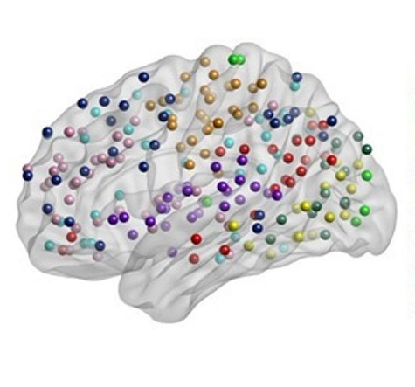
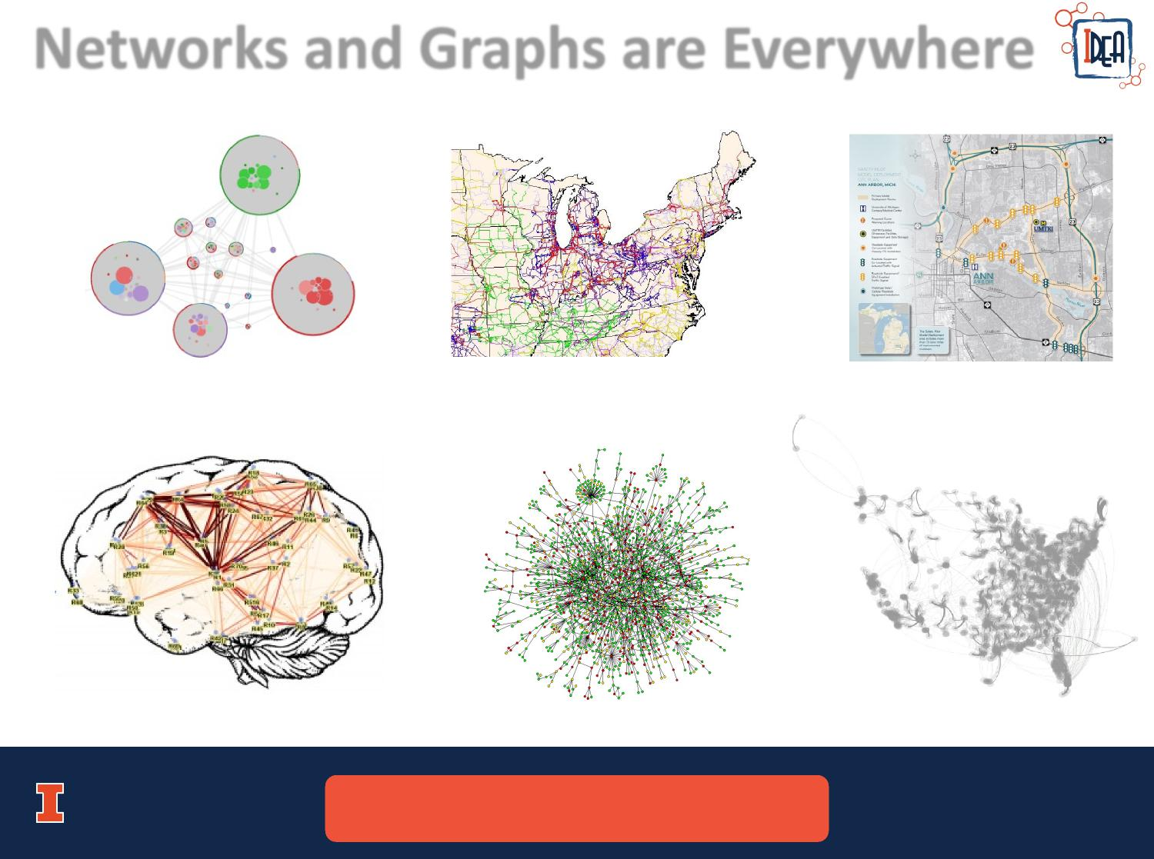
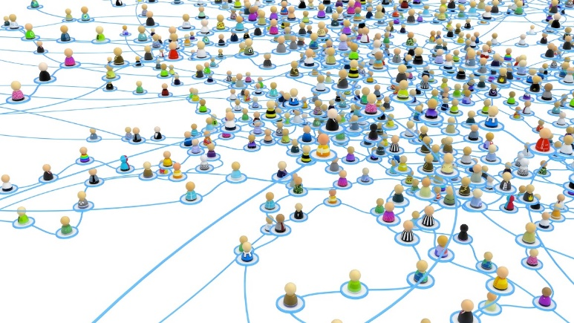
Prevalence of Graphs / Networks
Collaboration Networks
Social Networks
Biological Networks

Slide 5
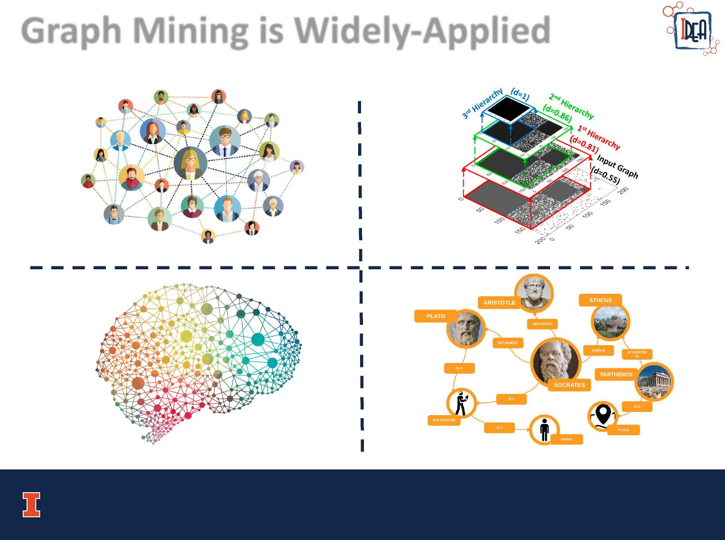
Mining from Graph
Social Influence / Policy Treatment
Biology, e.g., Brain Network
[1] Borgatti, S. P., Mehra, A., Brass, D. J., & Labianca, G.. Network Analysis in the Social Sciences. Science 2009.
[2] Wang, S., He, L., Cao, B., Lu, C. T., Yu, P. S., & Ragin, A. B.. Structural Deep Brain Network Mining. KDD 2017.

Slide 6
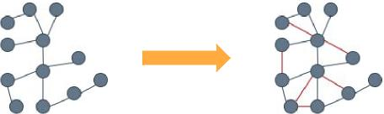
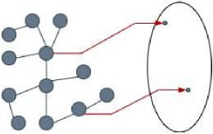
Common Tasks
Link Prediction
Node Representation Learning
Graph space
Embedding

Slide 7
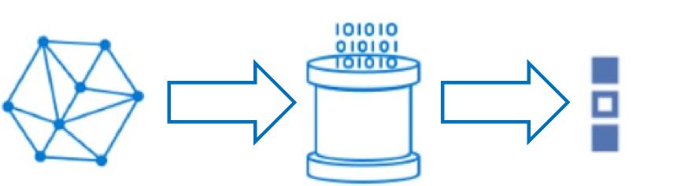
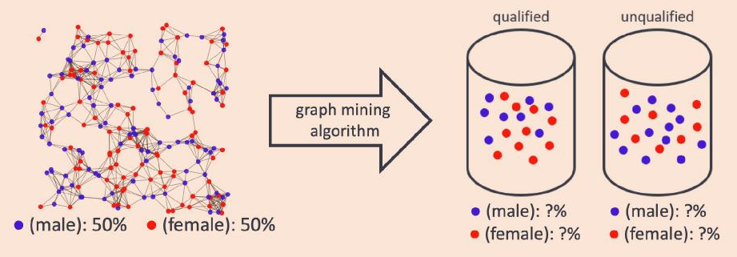
Pipeline of Graph Mining
Pipeline
Example:
Input Model Results

Slide 8
Fairness in Graph Mining
How to ensure the mining process is fair?
Why are two seemingly similar applicants belong to different admission groups?
Why does the algorithm ‘decide’ a certain individual likely receive benefits?
Why is a particular content more likely to go viral than the others?
How does the prior connectivity affect the algorithm results?
How do bot inputs change trending topics?

Slide 9
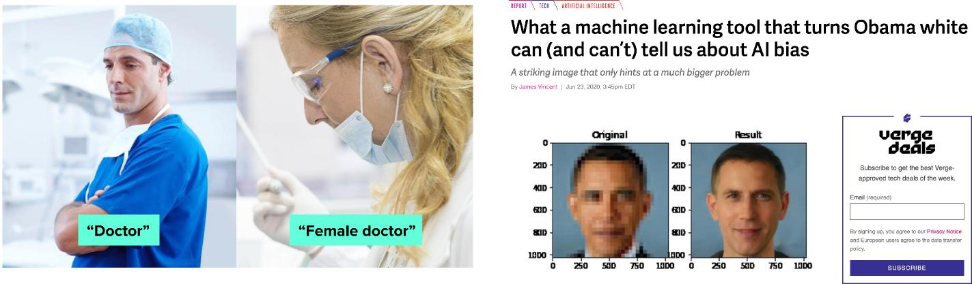
Algorithmic Fairness
Motivation: Mitigate unintentional bias caused by machine learning (ML) algorithms

Slide 10
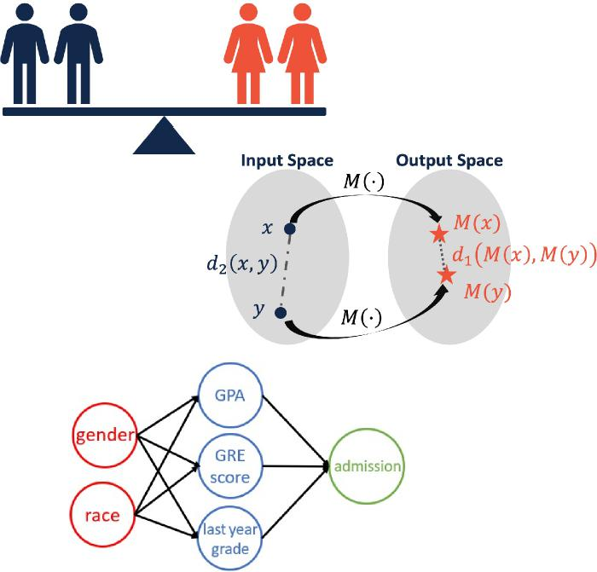
Algorithmic Fairness
Definition: Lack of favoritism from one side or another
Group fairness
Statistical parity
Equal opportunity
Individual fairness
More tailored than group fairness

Slide 11
Fairness in Graph Mining
Graph is a way to represent data or information using a collection of points, called "nodes," and lines connecting them, called "edges."
Nodes can represent anything, such as people in a social network or cities in a transportation system.
Vertex is a labeled node in graph.
Edges can represent relationships or connections between them, such as friendship or a road.
Edges are identified by the pair of vertices that they connect

Slide 12
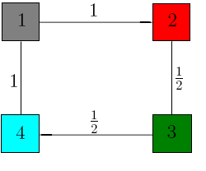
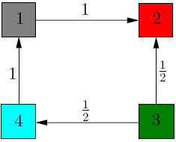
Graph Preliminaries
Undirected versus Directed Graphs (Modified from [1])
[1] http://pi.math.cornell.edu/~mec/Winter2009/RalucaRemus/Lecture2/lecture2.html

Slide 13

Graph Preliminaries
Transition Matrix $A$ (Modified from [1])
From Node
1 2 3 4
1
2
3
4
To
Node
[1] http://pi.math.cornell.edu/~mec/Winter2009/RalucaRemus/Lecture2/lecture2.html

Slide 14


Fairness on Graph Ranking: PageRank
Motivation
Finding the most important or influential nodes in graph
Used in Google search engine
Example: Important webpage -> linked by may others
PageRank algorithm:
Iteratively solve the following equation:
$$r=cAr+\left(1−c\right)e$$
PageRank solution:
$$r^{∗}=\left(1−c\right){\left(I−cA\right)}^{−1}e$$
$r:$ PageRank vector
$A$: transition matrix
$c$: damping factor
$e$: teleportation vector
[1] Page, L., Brin, S., Motwani, R., & Winograd, T.. The PageRank Citation Ranking: Bringing Order to the Web. Stanford InfoLab 1999.
[2] Haveliwala, T. H.. Topic-sensitive PageRank: A Context-Sensitive Ranking Algorithm for Web Search. TKDE 2003.
[3] Tong, H., Faloutsos, C., & Pan, J. Y.. Fast Random Walk with Restart and Its Applications. ICDM 2006

Slide 15
Fairness Measure for PageRank
𝜙-fair PageRank:
Given: Graph 𝐺
Definition:
PageRank vector is 𝜙-fair if 𝜙 fraction of total PageRank mass is allocated to the protected group
Variants:
Statistical Parity: 𝜙= fraction of protected group
Affirmative Action: 𝜙= a desired ratio
[1] Tsioutsiouliklis, S., Pitoura, E., Tsaparas, P., Kleftakis, I., & Mamoulis, N.. Fairness-Aware PageRank. WWW 2021.

Slide 16
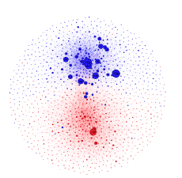

Fairness Measure for PageRank
Given:
A graph with transition matrix A
Partitions of nodes
Red nodes (R): protected group
Blue nodes (B): unprotected group
Find: A fair PageRank vector $\tilde{r}$ that is
𝜙-fair
Close to the original PageRank vector $r^{∗}$
[1] Tsioutsiouliklis, S., Pitoura, E., Tsaparas, P., Kleftakis, I., & Mamoulis, N.. Fairness-Aware PageRank. WWW 2021.

Slide 17

Fairness-aware PageRank: Mechanics
From PageRank Solution:
$$r^{∗}=\left(1−c\right){\left(I−cA\right)}^{−1}e$$
Teleportation vector $e$: Control the starting node where a random walker restarts the work over the graph
Can we let the walker restart at a protected node or its neighborhood?
Transition matrix $A$: Control the next step where the walker goes to
Can we let the walker go to the protected nodes more frequently?
Dumping factor $c$: Avoid sinks in the random walk (i.e., nodes without outgoing links)
[1] Tsioutsiouliklis, S., Pitoura, E., Tsaparas, P., Kleftakis, I., & Mamoulis, N.. Fairness-Aware PageRank. WWW 2021.

Slide 18
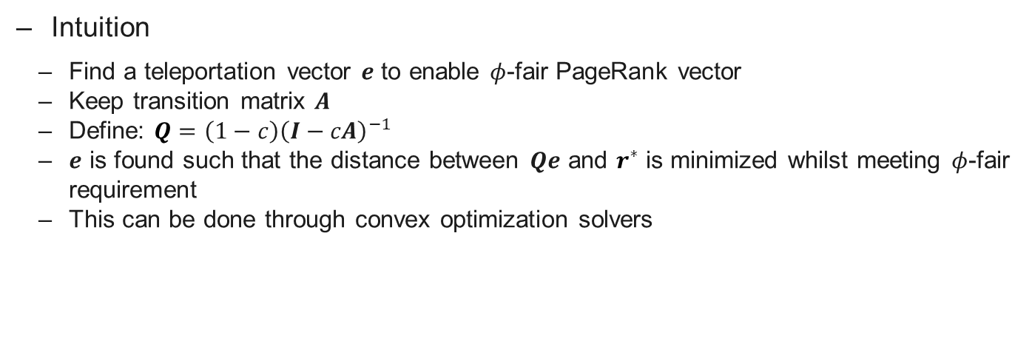
Fairness-sensitive PageRank: Teleportation Vector Based
Intuition
Find a teleportation vector 𝒆 to enable 𝜙-fair PageRank vector
Keep transition matrix 𝑨
Define: $Q=\left(1−c\right){\left(I−cA\right)}^{−1}$
𝒆 is found such that the distance between 𝑸𝒆 and $r^{∗}$ is minimized whilst meeting 𝜙-fair requirement
This can be done through convex optimization solvers
[1] Tsioutsiouliklis, S., Pitoura, E., Tsaparas, P., Kleftakis, I., & Mamoulis, N.. Fairness-Aware PageRank. WWW 2021.

Slide 19
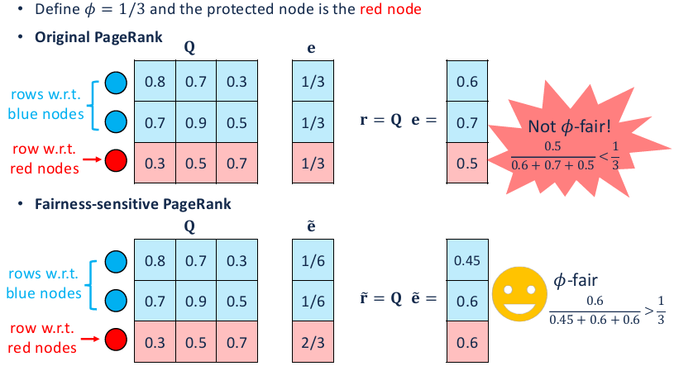
Example of Teleportation Vector Based

Slide 20
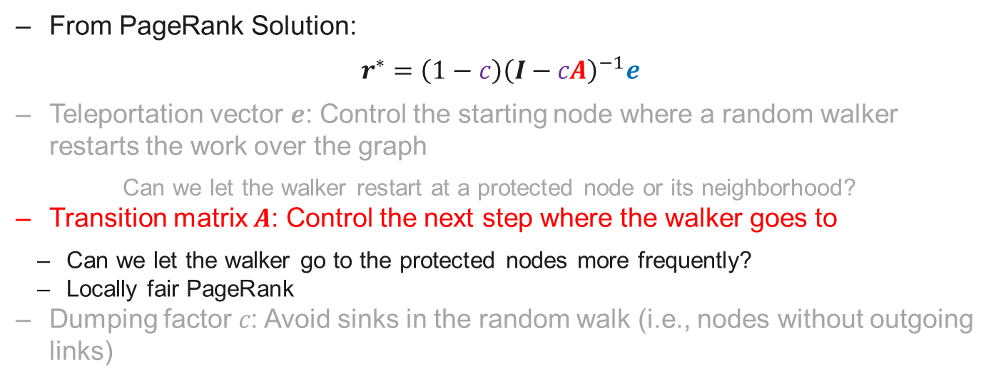
Fairness-aware PageRank: Transition Matrix Based
From PageRank Solution:
$$r^{∗}=\left(1−c\right){\left(I−cA\right)}^{−1}e$$
Teleportation vector 𝒆: Control the starting node where a random walker restarts the work over the graph
Can we let the walker restart at a protected node or its neighborhood?
Transition matrix 𝑨: Control the next step where the walker goes to
Can we let the walker go to the protected nodes more frequently?
Locally fair PageRank
Dumping factor 𝑐: Avoid sinks in the random walk (i.e., nodes without outgoing links)
[1] Tsioutsiouliklis, S., Pitoura, E., Tsaparas, P., Kleftakis, I., & Mamoulis, N.. Fairness-Aware PageRank. WWW 2021.

Slide 21
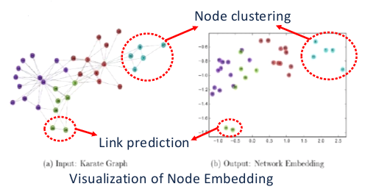
Fairness on Graph Embedding
Motivation: Learn low-dimensional node representations that preserve structural/attributive information
Common tasks:
Node classification
Link prediction
Node visualization
[1] Perozzi, B., Al-Rfou, R., & Skiena, S.. DeepWalk: Online Learning of Social Representations. KDD 2014.
[2] Tang, J., Qu, M., Wang, M., Zhang, M., Yan, J., & Mei, Q.. LINE: Large-scale Information Network Embedding. WWW 2015.
[3] Tang, J., Liu, J., Zhang, M., & Mei, Q.. Visualizing Large-scale and High-dimensional Data. WWW 2016.

Slide 22
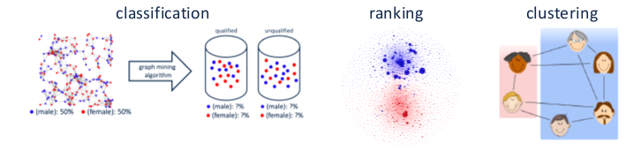
Fairness on Graph Embedding
Why fairness for embedding?
Allow multiple tasks that consider fairness (e.g., classification, ranking, clustering)
[1] Bose, A., & Hamilton, W.. Compositional Fairness Constraints for Graph Embeddings. ICML 2019.

Slide 23
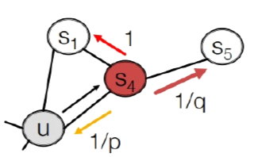
Fairness on Graph Embedding: Random Walk-based method – node2vec
Goal: Learn node embeddings that are predictive of nodes in its neighborhood
Key idea: Skip-gram model with biased random walk
Example:
Return parameter p: How fast the walk explores the neighborhood of the starting node
In-out parameter q: How fast the walk leaves the neighborhood of the starting node

Slide 24
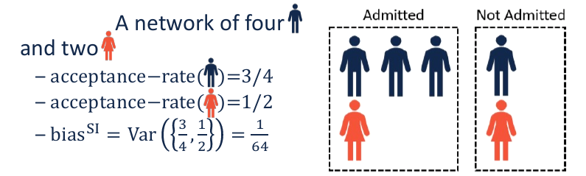
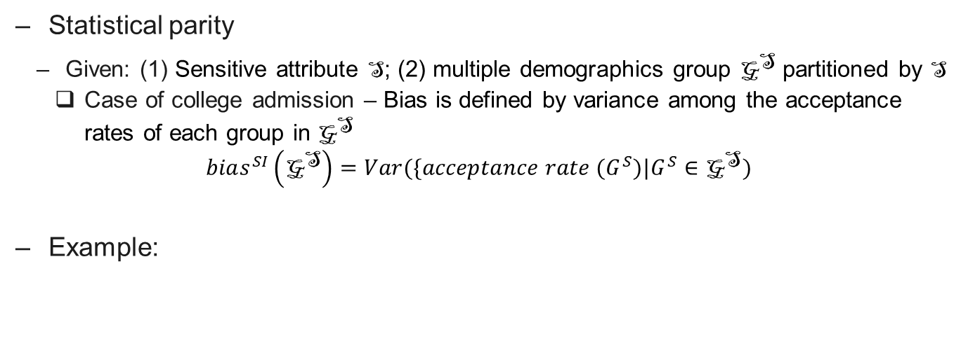
Fairness Measures – node2vec
Statistical parity
Given: (1) Sensitive attribute S; (2) multiple demographics group ${\text{G}}^{\text{S}}$ partitioned by S
Case of college admission – Bias is defined by variance among the acceptance rates of each group in ${\text{G}}^{\text{S}}$
$$bias^{SI}\left({\text{G}}^{\text{S}}\right)=Var(\{acceptance rate (G^{S})|G^{S}∈{\text{G}}^{\text{S}})$$
Example:
[1] Rahman, T., Surma, B., Backes, M., & Zhang, Y.. FairWalk: Towards Fair Graph Embedding. IJCAI 2019.

Slide 25
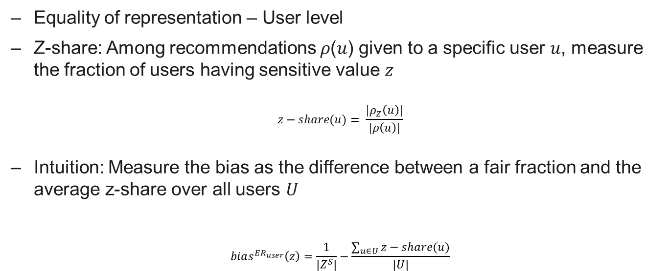
Fairness Measures – node2vec
Equality of representation – User level
Z-share: Among recommendations 𝜌(𝑢) given to a specific user 𝑢, measure the fraction of users having sensitive value 𝑧
$$z−share(u)= \frac{|ρ_{Z}\left(u\right)|}{|ρ\left(u\right)|}$$
Intuition: Measure the bias as the difference between a fair fraction and the average z-share over all users 𝑈
$$bias^{ER_{user}}\left(z\right)=\frac{1}{|Z^{S}|}−\frac{\sum_{u∈U}{z−share(u)}}{|U|}$$
[1] Rahman, T., Surma, B., Backes, M., & Zhang, Y.. FairWalk: Towards Fair Graph Embedding. IJCAI 2019.

Slide 26
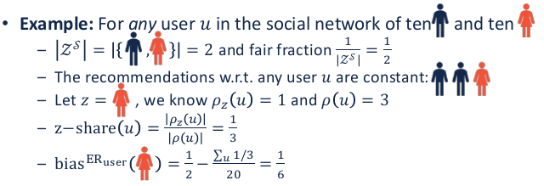
Fairness Measures – node2vec
Equality of representation – User level
[1] Rahman, T., Surma, B., Backes, M., & Zhang, Y.. FairWalk: Towards Fair Graph Embedding. IJCAI 2019.

Slide 27
Fairwalk: Solution
Key idea: Modify the random walk procedure in node2vec
Steps of Fairwalk
Partition neighbors into demographic groups
Assign equal probability to each demographic group
Select a demographic group to walk to
Randomly select a node within the chosen demographic group

Slide 28
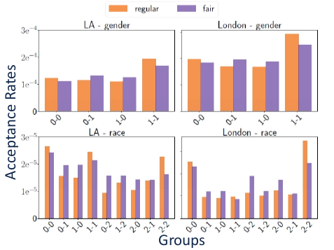
Fairwalk: Statistical Parity
Fairwalk achieves a more balanced acceptance rates among groups
[1] Rahman, T., Surma, B., Backes, M., & Zhang, Y.. FairWalk: Towards Fair Graph Embedding. IJCAI 2019.

Slide 29
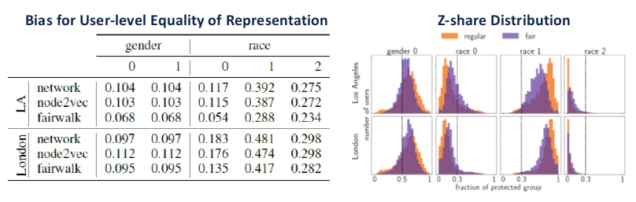
Fairwalk: User-level Equality of Representation
Fairwalk decreases the user-level bias
Z-share distribution of Fairwalk leans towards the fair fraction
[1] Rahman, T., Surma, B., Backes, M., & Zhang, Y.. FairWalk: Towards Fair Graph Embedding. IJCAI 2019.

Slide 30
Remarks and Summary
Fairness-Aware PageRank vs Fairwalk
Fairness-aware PageRank: The minority group should have a certain proportion of PageRank probability mass
Fairwalk: All demographic group have the same random walk transition probability mass
Node2vec vs Fairwalk
Node2vec: skip-gram model + walk sequences by original random walk
Fairwalk: skip-gram model + walk sequences by fair random walk

Slide 31
Further Topics of Fairness on Graph
Individual fairness [1]
Counterfactual fairness [2]
Degree-related fairness [3]
Rawlsian fairness [4]
[1] Kang, J., He, J., Maciejewski, R., & Tong, H.. InFoRM: Individual Fairness on Graph Mining. KDD 2020.
[2] Agarwal, C., Lakkaraju, H., & Zitnik, M.. Towards a Unified Framework for Fair and Stable Graph Representation Learning. UAI 2021.
[3] Tang, X., Yao, H., Sun, Y., Wang, Y., Tang, J., Aggarwal, C., ... & Wang, S.. Investigating and Mitigating Degree-Related Biases in Graph Convolutional Networks. CIKM 2020.
[4] Rahmattalabi, A., Vayanos, P., Fulginiti, A., Rice, E., Wilder, B., Yadav, A., & Tambe, M.. Exploring Algorithmic Fairness in Robust Graph Covering Problems. NeurIPS 2019.

